Slide 1
Sentiment Analysis and Prediction of Flipkart Reviews
Presented by: Dhruv Nishesh Patel
Enrollment number : AU2444003 Date: 09/04/25

Slide 2
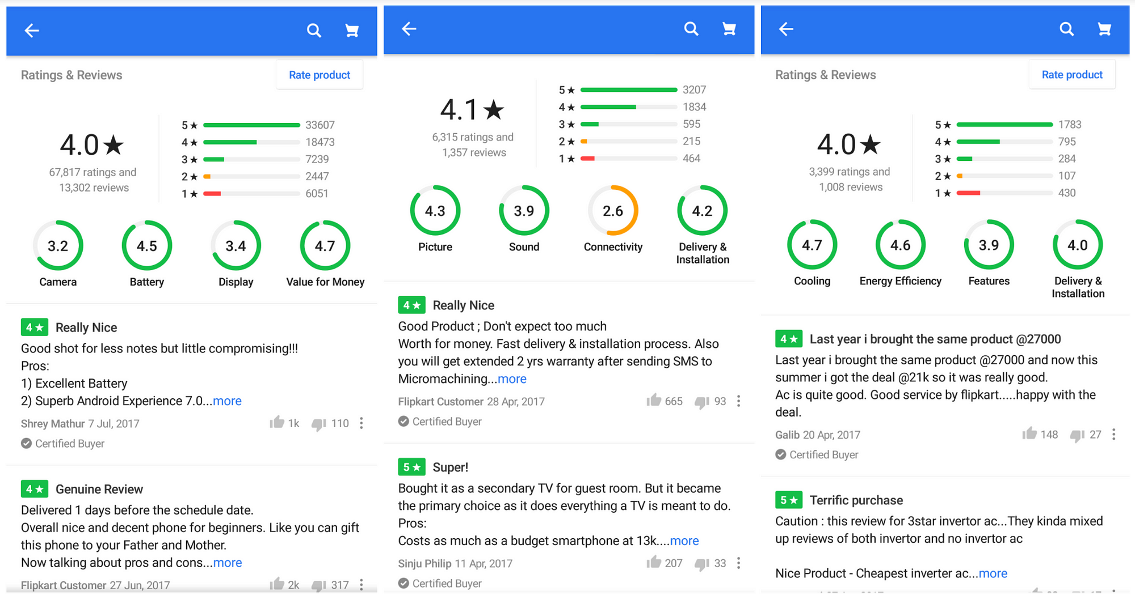
Problem Statement
Customer reviews play a crucial role in e-commerce, influencing purchasing decisions and brand reputation. However, challenges such as fake reviews, unstructured text, and sentiment imbalance make analysis complex and less reliable.
My project aims to develop a Machine Learning model to accurately classify Flipkart reviews into Positive, Negative, or Neutral categories, enabling better sentiment insights and data-driven decision-making for businesses and consumers.
Project Overview
Data Collection
Data Preprocessing
Feature Engineering
Exploratory Data Analysis (EDA)
Feature Extraction
Model Training
Evaluation & Visualization

Slide 3
1. Data Collection
Objective:
To gather genuine customer reviews for precise sentiment analysis and deeper consumer insights.
Approach:
Web Scraping Powerhouse: Leveraged Selenium and BeautifulSoup to dynamically extract real customer feedback on 5G mobile phones from Flipkart.
Smart Pagination Handling: Implemented automated navigation across multiple pages, ensuring a rich and diverse dataset for analysis.
Data Structuring: Stored extracted information in a clean, structured format (CSV) for seamless preprocessing and modeling.
Key Information Extracted:
Product Name – Identifies the reviewed item.
Overall Rating – Customer-assigned rating for the product.
Review Content – Includes detailed feedback for sentiment analysis.

Slide 4
2. Data Preprocessing
Objective:
Prepare the raw text data by cleaning and standardizing it for analysis.
Steps Taken:
Handling Missing Values: Removed empty or null reviews.
Cleaning Text Data:
Removed emojis, special characters, URLs, hashtags, and mentions.
Converted text to lowercase.
Applied lemmatization for text normalization.
Stopwords Removal:
Removed common words like 'the', 'is', 'and', etc., using NLTK's stopwords library.

Slide 5
3. Feature Engineering
Objective:
Enhancing data by adding new meaningful attributes.
Techniques Used:
Generated Cleaned Reviews Column: Processed text stored separately.
Extracted Sentiment Scores:
Used TextBlob & VADER to determine polarity.
Mapped scores to Positive, Negative, and Neutral labels.

Slide 6
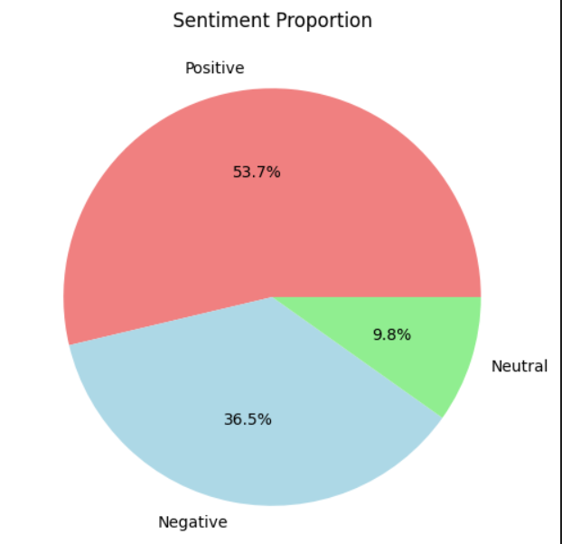
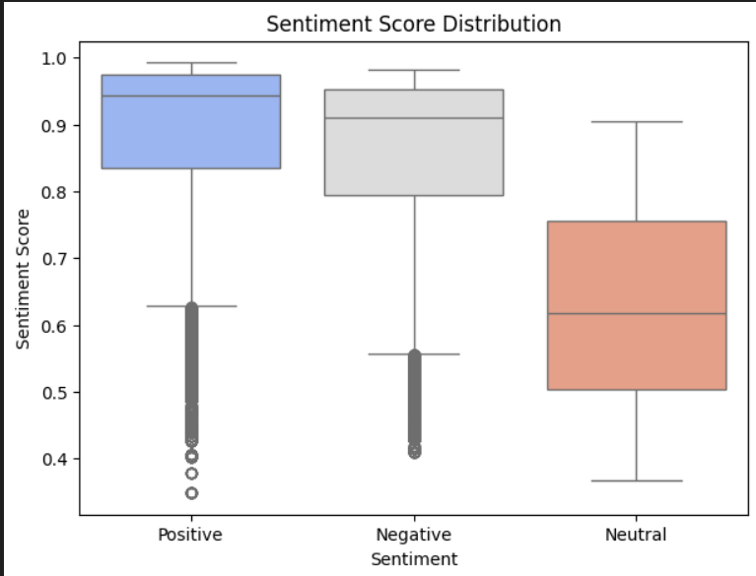
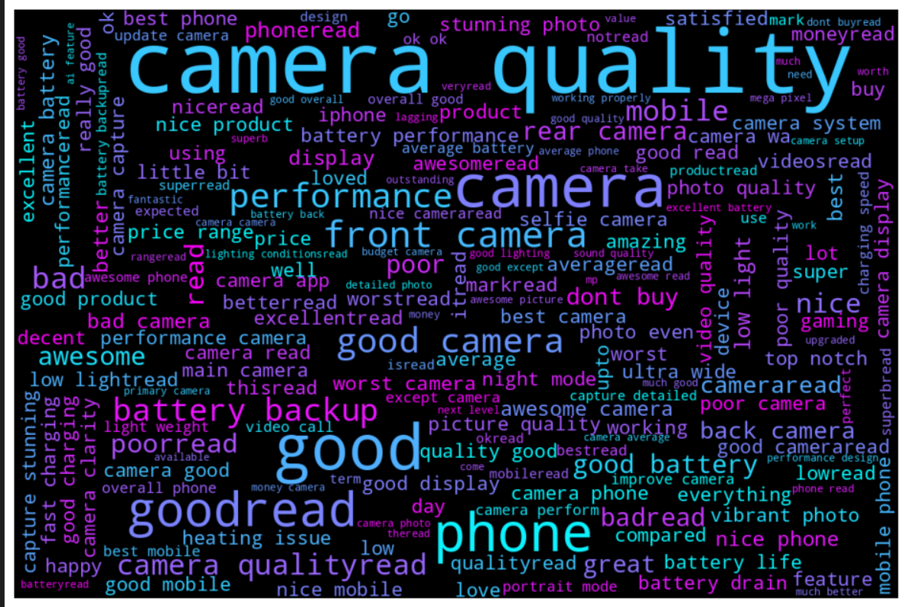
4. Exploratory Data Analysis (EDA)
Objective:
Understand the distribution of data and uncover patterns.
Visualization Techniques Used:
Overall Ratings Distribution:
Plotted a count plot of ratings to analyze frequency.
Word Cloud:
Displayed frequently occurring words in reviews.
Sentiment Distribution:
Count plot for sentiment categories (Positive, Negative, Neutral).
Boxplot & Violin Plot:
Analyzed Sentiment Score distribution.
Histogram of Sentiment Scores:
Visualized the density of sentiment scores.

Slide 7
5. Feature Extraction
Objective:
Convert textual data into numerical representation for model training.
Techniques Used:
TF-IDF Vectorization:
Transformed the reviews into vectors by using TF-IDF Vectorizer.
Label Encoding:
Converted sentiment labels (Positive, Negative, Neutral) into numerical values.

Slide 8
6. Model Training
Objective:
Train a machine learning model to classify reviews based on sentiment.
Steps Taken:
Train-Test Split:
Split data into 80% training & 20% testing.
Models Used:
Multinomial Naïve Bayes (Best Performing)
Decision Tree
Random Forest
XGBoost
Final Model Selection:
Multinomial Naïve Bayes achieved the best accuracy.

Slide 9
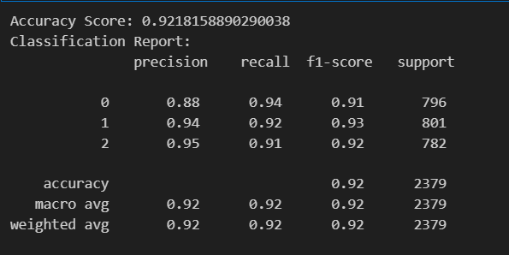
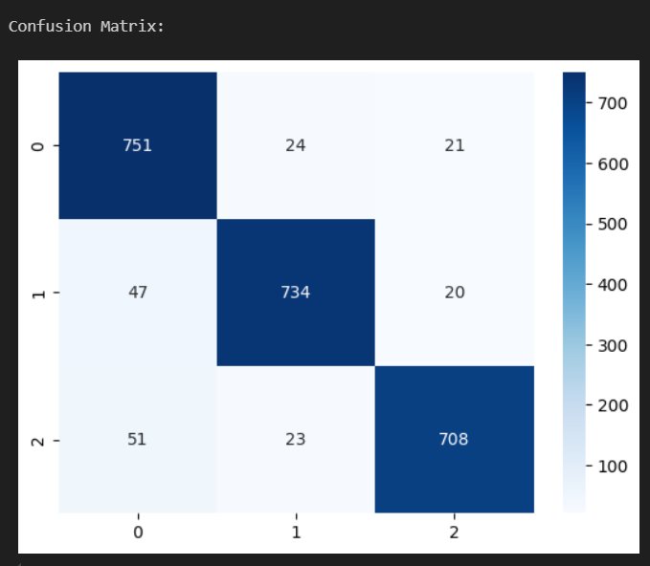
7. Evaluation
Objective:
Assess model performance through metrics and visualizations.
Evaluation Metrics Used:
Accuracy Score: Measured how well the model predicts sentiments. (Achieved 92% accuracy).
Classification Report: Showed precision, recall, and F1-score.
Confusion Matrix: Displayed correct vs incorrect predictions using a heatmap.

Slide 10
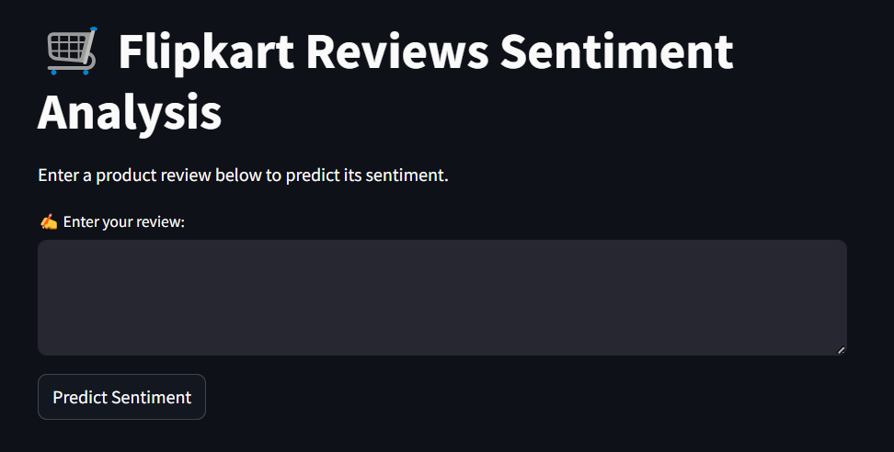
8. Web App Interface
Objective:
Deploy the trained model as an interactive web application.
Implementation:
Framework Used: Streamlit for building a user-friendly interface.
Features:
User can input a review.
Model predicts sentiment in real-time.
Displays sentiment category (Positive, Negative, Neutral).

Slide 11
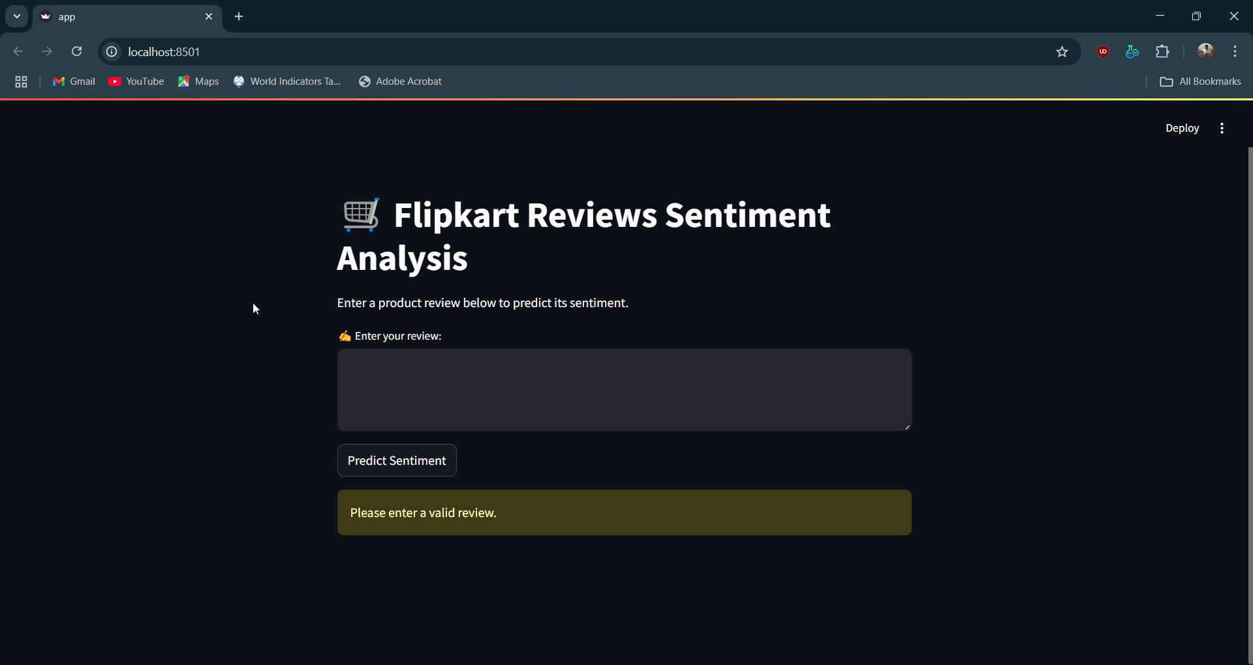
Streamlit Web App Demo

